Slide 1
COMP3074 Mobile App Development I
Week 1

Slide 2
This week
Introduction
About this course
Evaluation system
Introduction to mobile app dev
Overview
App types
App components
Android environment overview
My first Android app

Slide 3
About this course: Instructor
Przemyslaw (Pshemek) Pawluk
Office: C467
Email: ppawluk@georgebrown.ca
Ext: 6642
As we currently exist off-campus, please use email as a primary mode of communication. I will do my best to answer all your emails within 24h (except for weekends and holidays)

Slide 4
Office hours
As everything else, office hours will be handled online
Please contact me by email to schedule a zoom meeting (24h notice)
I will be available for such calls on Mondays 12-2pm

Slide 5
About this course
This course provides the students with hands-on experience in developing and deploying wireless applications on mobile platforms with strong emphasis on Android and React native.
Coursework emphasizes how to create cross device GUIs, handle events, access remote services and store and retrieve data on the device.
It introduces also basic information on a cross-platform mobile development using all previously listed features on React native.

Slide 6

What you should know starting the course
Basic Java – classes, interfaces, inheritance, loops, branching
HTML, CSS, JavaScript – JQuery

Slide 7
What we will do: Android
Android infrastructure
Activities, Services and other components
UI components – Views
Persistent storage - SQLite
Location services and maps
Accessing external data – Web Services
Sensors
Signing and publishing the app

Slide 8
What we will do: React
React native infrastructure
React components
UI components – Views
Persistent storage
Location services and maps
Accessing external data – Web Services
Sensors
Signing and publishing the app – cross platform

Slide 9
Evaluation system
Assessment Tool: | Description: | Date / Week: | % of Final Grade:
Lecture quizzes | Quizzes covering last topics discussed in the lecture and lab | Week 2-14 | 10
Lab Exercises | Grade calculated based on atKlass and submissions | Week 1-14 | 10
Lab test 1 | Limited time programming task | Week 7 | 10
Lab test 2 | Limited time programming task | Week 12 | 10
Assignment 1 | Take-home assignment covering basic functionality in Android | Week 3 (due week 5) | 10
Assignment 2 | Take-home assignment extending functionality of A1 | Week 5 (due week 9) | 10
Project | Team project that covers multiple topics and requires incremental work. | Due week 14 | 20
Final Exam | Multiple choices, along with coding questions. | Week 15 | 20
TOTAL: |  |  | 100%

Slide 10
Assignments
Assignments will cover main topics from the lectures. Students will be required to use theoretical information from the lecture in the practical task.
Students should work independently
Late submissions will be punished by 10% deduction for each day past due day. After 10 days you receive 0 automatically
Exceptions to this rule may be granted at professor’s discretion based on provided documentation
Students will be required to submit a short (3-5min) video in which they explain the project and show how it works (screen capture)

Slide 11
Labtests
Labtest will cover main topics from the lectures. Students will be required to use theoretical information from the lecture in the practical task.
Time for the labtest will be limted, and students will be required to submit the work within given time frame.
Students should work independently
Students will be required to complete the test at the specified time. Missing the labtest will result is automatic 0
Exceptions to this rule may be granted at professor’s discretion based on provided documentation

Slide 12
Project
A group project (you may work in groups formed for the Capstone Project)
Students are required to complete the signup for the project before the given deadline
Project will be divided into milestones, in each milestone deliverables should be discussed with the professor and the entire team
Late submission policy disused in the assignment section applies
Students can propose a topic (e.g. your Capstone Project) or use provided spec.

Slide 13
Quizzes
A short quizzes will take place during the lecture time
Quizzes will be handled online
Code for each quiz will be released during the lecture and time will be limited to the lecture
There will be no makeup quizzes

Slide 14
Lab exercises
Lab exercises are tasks that are realized in the lab with the professor
After each lab session you will have time till the end of the day to submit your solution on BB
There is no makeup for missed lab exercises

Slide 15
Final Exam
Multiple choice test, along with coding questions
Limited time
Considering current situation, it will be handled most likely online, however, this may change
Exam will have to be completed at prescribe day/time

Slide 16
Grading System
The standard George Brown College grading scale is used to convert percentage to the letter grade

Slide 17
Books and materials
Required:
Android: https://books.goalkicker.com/AndroidBook/
React Native: https://books.goalkicker.com/ReactNativeBook/
Recommended Resources/References
http://developer.android.com/index.html
https://reactnative.dev/docs/getting-started

Slide 18


QUESTIONS

Slide 19
Mobile Apps – where to start

Slide 20
What is your favorite mobile app?
Do you have an app that you use everyday? Or maybe multiple times a day?
What makes it good? Share your ideas on Padlet (upvote those that you agree with)
https://padlet.com/pawluk/xrituv49z2b05xp

Slide 21

Simplicity
Simplicity is a key ingredient of the mobile app success!
The most successful apps are doing one thing, but they do it perfectly.

Slide 22
Know the user
To create a good application, you need to know the requirements
Source of them are users
Users that you don’t know yet
How do you gather the requirements then?
Learn from best and from their mistakes
Let your users guide you!

Slide 23
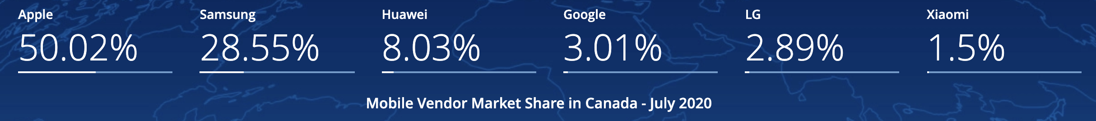
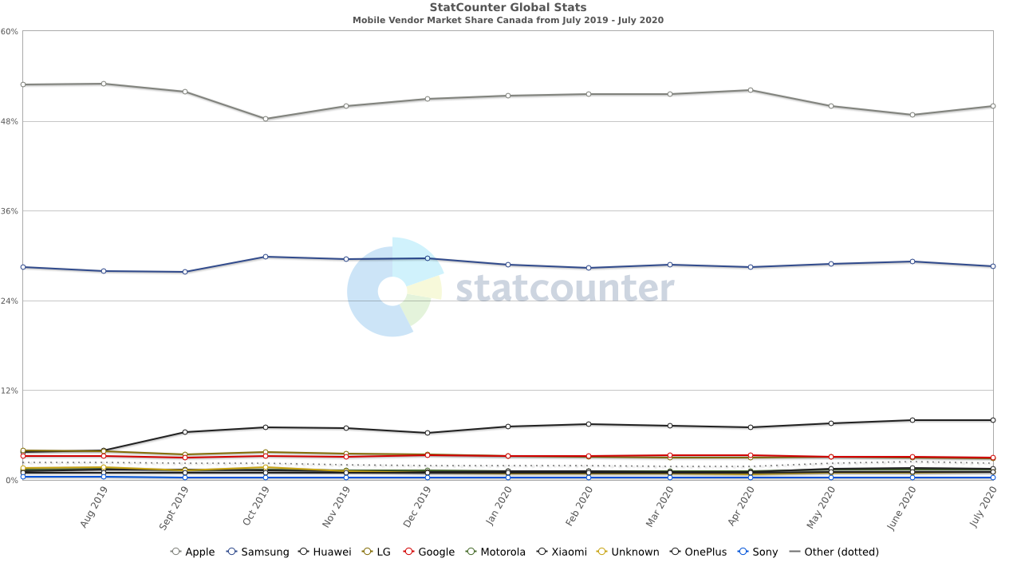
Mobile platforms Canada

Slide 24
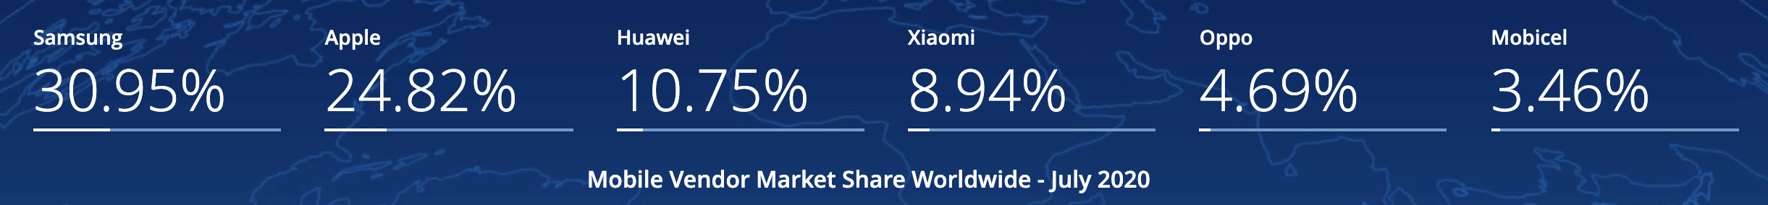
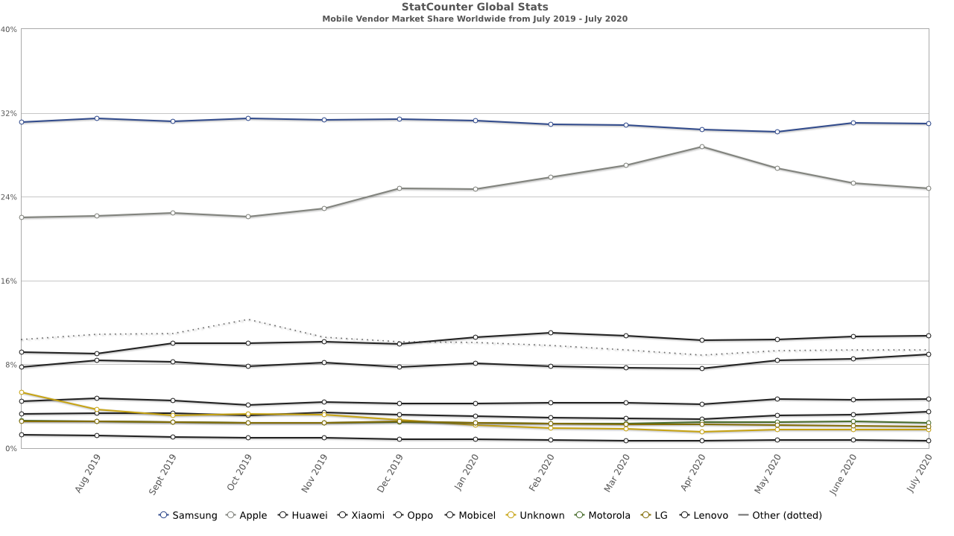
Mobile platforms Worldwide

Slide 25
Android
Android is a mobile operating system based on a modified version of the Linux kernel and other open source software, designed primarily for touchscreen mobile devices such as smartphones and tablets.
Android is developed by a consortium of developers known as the Open Handset Alliance and commercially sponsored by Google. It was unveiled in November 2007, with the first commercial Android device launched in September 2008.
It is free and open source software; its source code is known as Android Open Source Project (AOSP) which is primarily licensed under the Apache License.
HTC Dream or T-Mobile G1, the first commercially released device running Android

Slide 26
Android
The source code has been used to develop variants of Android on a range of other electronics, such as game consoles, digital cameras, PCs and others, each with a specialized user interface.
Some well-known derivatives include Android TV for televisions and Wear OS for wearables, both developed by Google. Software packages on Android, which use the APK format, are generally distributed through proprietary application stores like Google Play Store, Samsung Galaxy Store, and Huawei AppGallery, or open source platforms like Aptoide or F-Droid.

Slide 27
Android Architecture

Slide 28
Dalvik and ART
Dalvik is a virtual machine (VM) designed and written by Dan Bornstein at Google. Although the bytecode formats are a little different, Dalvik is essentially a Java virtual machine optimized for low memory requirements. It allows multiple VM instances to run at once and takes advantage of the underlying operating system (Linux) for security and process isolation.
Android Runtime (ART) is an application runtime environment used by the Android operating system. Replacing Dalvik. ART performs the translation of the application's bytecode into native instructions that are later executed by the device's runtime environment.

Slide 29
Dalvik and ART
Android 4.4 "KitKat" brought a technology preview of ART, including it as an alternative runtime environment and keeping Dalvik as the default virtual machine. In the subsequent major Android release, Android 5.0 "Lollipop", Dalvik was entirely replaced by ART.
Android 7.0 "Nougat" introduced a JIT compiler with code profiling to ART, which lets it constantly improve the performance of Android apps as they run. The JIT compiler complements ART's current Ahead of Time compiler and helps improve runtime performance.

Slide 30
Main components

Slide 31
Activity
An activity is a single, focused thing that the user can do. Almost all activities interact with the user, so the Activity class takes care of creating a window for you in which you can place your UI with setContentView(View).
While activities are often presented to the user as full-screen windows, they can also be used in other ways: as floating windows (via a theme with R.attr.windowIsFloating set), Multi-Window mode or embedded into other windows.

Slide 32
Intent
An intent is an abstract description of an operation to be performed. It can be used with startActivity(Intent) to launch an Activity, broadcastIntent to send it to any interested BroadcastReceiver components, and startService(Intent) or bindService(Intent, ServiceConnection, int) to communicate with a background Service.
An Intent provides a facility for performing late runtime binding between the code in different applications. Its most significant use is in the launching of activities, where it can be thought of as the glue between activities. It is basically a passive data structure holding an abstract description of an action to be performed.

Slide 33
Service
A Service is an application component representing either an application's desire to perform a longer-running operation while not interacting with the user or to supply functionality for other applications to use. Each service class must have a corresponding <service> declaration in its package's AndroidManifest.xml. Services can be started with Context.startService() and Context.bindService().
Note that services, like other application objects, run in the main thread of their hosting process. This means that, if your service is going to do any CPU intensive (such as MP3 playback) or blocking (such as networking) operations, it should spawn its own thread in which to do that work. The JobIntentService class is available as a standard implementation of Service that has its own thread where it schedules its work to be done.

Slide 34
Content providers
A content provider manages access to a central repository of data. A provider is part of an Android application, which often provides its own UI for working with the data. However, content providers are primarily intended to be used by other applications, which access the provider using a provider client object. Together, providers and provider clients offer a consistent, standard interface to data that also handles inter-process communication and secure data access.
Typically you work with content providers in one of two scenarios; you may want to implement code to access an existing content provider in another application, or you may want to create a new content provider in your application to share data with other applications. This topic covers the basics of working with existing content providers. To learn more about implementing content providers in your own applications, see Creating a content provider.

Slide 35
Introduction to App Development
Please, watch the videos in this short course
https://www.linkedin.com/learning/android-app-development-quick-start/

